Slide 1
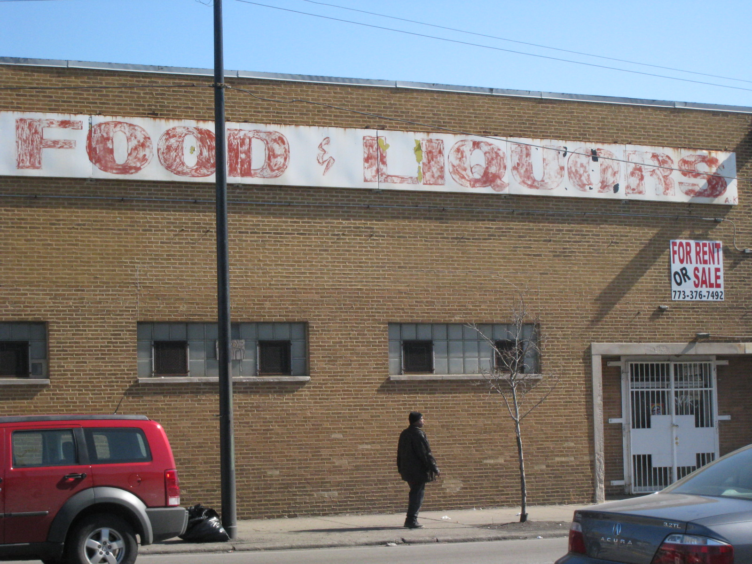
Problem
40M Americans are
Food Insecure
Living in Urban Areas

Slide 2
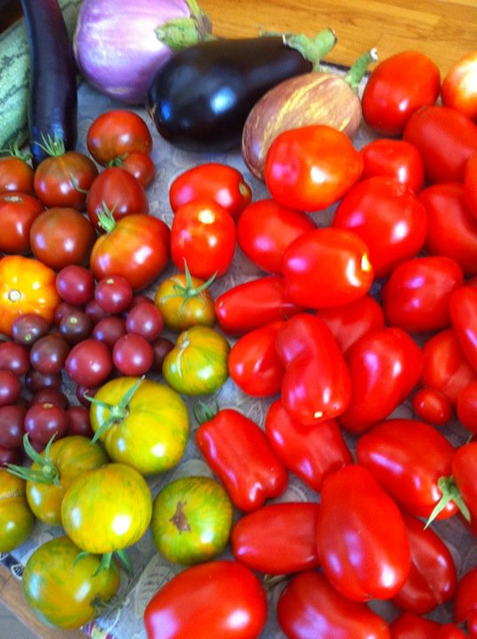
Surplus
40M Americans are
Food Insecure
Living in Urban Areas
50M+ American Households are
Growing Food
Average yield 100 lbs/4x8 plot

Slide 3



Neighbor Sue
Local Joe
How?

Slide 4

Surplus Food
Rescue
Neighbor Sue
Local Joe
Lovin Spoonfuls
Food 4 Free
Boston Gleaners

Slide 5
Surplus Food
Rescue
Neighbor Sue
Local Joe
Lovin Spoonfuls
Food 4 Free
Boston Gleaners

Slide 6
Solution
Undernourished and underserved communities
Recipients of food assistance

Slide 7
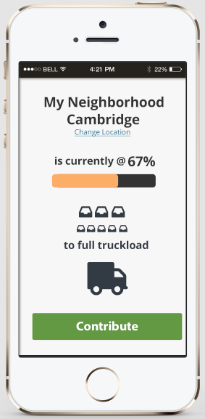
Neighbor Sue
…wants to donate her produce.

Slide 8
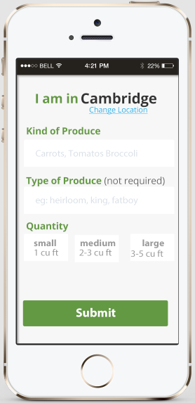
Neighbor Sue
…enters what in her garden is almost ripe.

Slide 9
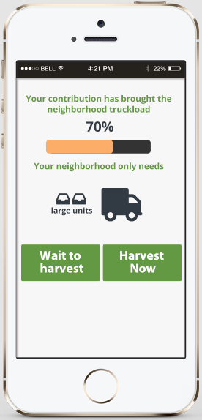
Neighbor Sue
…chooses whether to wait for home pickup or deliver to a drop location.

Slide 10
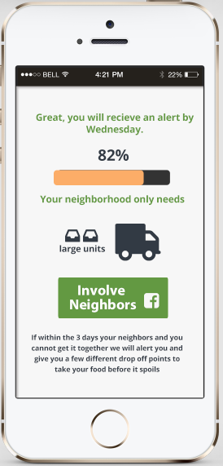
IF:
Neighbor Sue
…wants to have her produce picked up…

Slide 11
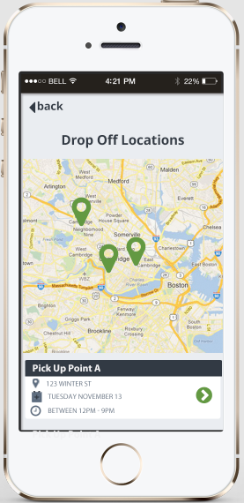
IF:
Neighbor Sue
…wants drop off her produce…

Slide 12
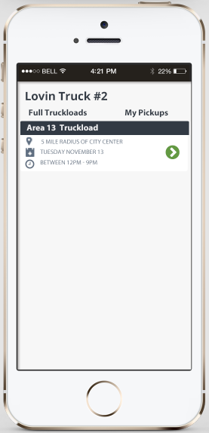
Lovin Spoonful
…is shown what areas have full truckloads.

Slide 13
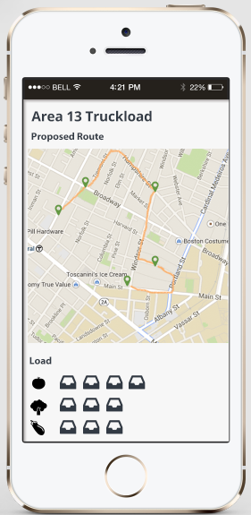
Lovin Spoonful
…chooses to make pick-ups in an area.

Slide 14
Growth?
Undernourished and underserved communities
Recipients of food assistance

Slide 15
Growth?
Undernourished and underserved communities
Recipients of food assistance

Slide 16
Growth.
Undernourished and underserved communities
Recipients of food assistance

